Slide 1
HOTEL RECOMMENDATION TOOL USING WEBSCRAPING AND SENTIMENT ANALYSIS
Web Mining and Social Network Analysis – CSI3033

Slide 2
Teammates
01
02
03
Siddarth SR Pillai-21MIC0048
Akshaj Anil – 21MIC0186
Ragul G -21MIC0174

Slide 3
Table of contents
01
05
02
06
03
04
Introduction
Architectural Design
Aim, Objectives and Motivation
Implementation
Literature Survey
07
Results
Problem Statement
08
Conclusion

Slide 4
01
Introduction

Slide 5

Introduction
The hospitality industry in India caters to both local and international travelers, who are drawn to the region's cultural richness and scenic beauty. Accommodation choice is influenced by online reviews, which have become vital for both travelers and hotels. This project analyzes hotel reviews to identify top-performing hotels and key factors contributing to customer satisfaction and it aims to offer valuable insights for travelers and the local hospitality industry.

Slide 6
02
Aim, Objectives and Motivation

Slide 7
Aim
Motivation
This project is all about gathering hotel reviews from the internet to learn from them. Each review tells a story and shares feelings, giving us lots of useful information. By focusing on making hotels better and giving guests great experiences, we're helping the hospitality industry improve. We're using data to help hotels make smart choices and provide better service. This project encourages new ideas and changes how hotels listen to feedback using technology. It's not just about collecting information—it's about making guests happier, always finding ways to do better, and shaping the future of hospitality.
This project delves into analyzing hotel reviews in Tamil Nadu using web scraping and sentiment analysis techniques to uncover patterns, preferences, and perceptions among guests. By systematically examining these reviews, the study aims to identify top-performing hotels, highlight key attributes contributing to customer satisfaction, and offer valuable insights beneficial to both travelers and the local hospitality industry.

Slide 8
Objectives
1)The main objective of our system is to make the user more convenient to identify the reviews from multiple sources across the web, providing a more comprehensive view of the hotel's strengths and weaknesses as perceived by past guests.
2) The project aims to develop a web application for hotel search, integrating sentiment analysis to gauge customer feedback.
3) Using web mining techniques, it retrieves and analyzes data from Booking.com to provide users with comprehensive information about hotels in a specified location. The objective is to enhance user decision-making by offering insights derived from both quantitative ratings and qualitative sentiment scores of hotel reviews.
4) We have done sentimental analysis algorithms such as VADER to analyze the sentiment of the reviews.
5)The output will be name of the hotel, location, rating and sentiment score
Along with it the graphical comparison of the sentimental scores will be displayed.

Slide 9
03
Literature Survey

Slide 10
Author | Date | Title | Summary | Algorithm | Disadvantage
Fitra A. Bachtiar, Wirdhayanti Paulina | March 2020 | Text mining for aspect based sentiment analysis on customer review: A case study in the hotel industry | The main aim of the study is to perform aspect-based sentiment analysis on customer reviews within the hotel industry. This involves identifying specific aspects or features of hotels that customers discuss in their reviews and analyzing the sentiment associated with each aspect. | Lexicon-Based: Uses sentiment lexicons like VADER and SentiWordNet to assign sentiment scores to words or phrases. Machine Learning: Utilizes supervised or deep learning algorithms trained on labeled data to classify aspect sentiment. Aspect-Based Attention: In neural network architectures, attention mechanisms focus on relevant text parts for each aspect, assigning different weights to words or phrases. | Aspect-based sentiment analysis faces challenges including language ambiguity, domain-specific knowledge reliance, linguistic nuances management (e.g., negation, sarcasm), data sparsity and imbalance handling, and coping with subjectivity and variability in sentiment interpretation due to individual biases and cultural differences.

Slide 11
Author | Date | Title | Summary | Algorithm | Disadvantage
Wu He, Xin Tian | July 2016 | Application of social media analytics: A case of analyzing online hotel reviews | This study uses social media analytics to analyze hotel reviews from platforms like TripAdvisor or Yelp. Techniques such as sentiment analysis and topic modeling are applied to understand customer preferences. | Sentiment Analysis: Determines sentiment polarity (positive, negative, neutral) of reviews using algorithms like VADER, SentiWordNet, and machine learning classifiers. Topic Modeling: Identifies key themes or topics within reviews using techniques like LDA or NMF. Opinion Mining: Extracts subjective information such as opinions, attitudes, and emotions from reviews using NLP techniques and machine learning models. | Sentiment analysis faces challenges in understanding context, particularly with sarcasm and cultural nuances, and relies heavily on predefined lexicons, potentially leading to inaccuracies. Topic modeling may produce topics that are hard to interpret or not aligned with management expectations, making it difficult to derive actionable insights.

Slide 12
Author | Date | Title | Summary | Algorithm | Disadvantage
Arie Satia Dharma, Yosua Giat Raja Saragih | Oct 3, 2022 | Comparison of Feature Extraction Methods on Sentiment Analysis in Hotel Reviews | This study compares feature extraction methods for sentiment analysis in hotel reviews. It evaluates techniques like Bag-of-Words, TF-IDF, word embeddings, and n-grams for their effectiveness in classifying sentiments. The findings offer guidance for selecting suitable methods in hotel industry sentiment analysis tasks. | Text representation methods like Bag-of-Words (BoW) count word frequencies in documents to create vectors. Term Frequency-Inverse Document Frequency (TF-IDF) assigns weights based on word frequency and rarity in the corpus. Word Embeddings create dense vectors capturing word semantics, learned from large corpora using techniques like Word2Vec, GloVe, or FastText. These techniques are essential for tasks like sentiment analysis in natural language processing. | Sentiment analysis faces challenges in understanding context, especially with sarcasm or cultural nuances, potentially leading to misinterpretations. Reliance on predefined sentiment lexicons may result in inaccuracies due to missing terms or expressions. Interpreting results from topic modeling may also be challenging, hindering the derivation of actionable insights.

Slide 13
04
Problem Statement

Slide 14
Problem Statement
Web hotel reviews aim to collect, analyze and extract actionable insights from various online platforms to enhance guest satisfaction and operational excellence in the hospitality industry.The problem revolves around on how how to efficiently gather, analyze, and make use of hotel reviews found on different online platforms in the hospitality industry. The main challenge is to create a strong method for collecting review data from the web and then using sentiment analysis techniques to understand what the data means. In short, the goal is to build a reliable and precise system for scraping hotel reviews from the internet, which can help make decisions based on data and constantly improve the hospitality sector.

Slide 15
05
Architectural Diagram

Slide 16
Application Design
The application is built using Flask for hotel sentiment analysis and visualization.
It follows a client-server architecture, with Python handling server-side tasks and HTML, CSS, and JavaScript managing client-side presentation.
Flask defines routes and manages user requests, such as hotel searches.
Web scraping with BeautifulSoup extracts hotel data from Booking.com, including names, locations, ratings, and review URLs.
Sentiment analysis of hotel reviews is done using the VADER sentiment analyzer from NLTK.
Geocoding techniques via the Nominatim API provide latitude and longitude coordinates for hotel locations, enabling map visualization.
The user interface emphasizes simplicity and usability, with clean HTML templates styled with CSS.

Slide 17
Application Design
8.Interactive elements like map markers and bar charts enhance user engagement and exploration of hotel data.
9. Overall, the design aims for functionality, performance, and user engagement to provide a comprehensive hotel search and sentiment analysis tool.

Slide 18
Application Design
Design modules
Web Application Framework (Flask)
HTML Templates
Web Scraping (BeautifulSoup)
HTTP Requests (requests)
Sentiment Analysis (NLTK)
Geocoding (Nominatim API)
Data Processing and Sorting
Data Visualization (Leaflet, Chart.js)
Core modules
Flask
Requests
Beautiful soap
NTLK(Natural language tool kit)

Slide 19
Workflow Diagram
User Input and Request Handling
Web Scraping Hotel Data
Coordinate Retrieval
Sentiment Analysis of Reviews
Data Processing and Sorting
Rendering Results to the User

Slide 20
06
Implementation

Slide 21
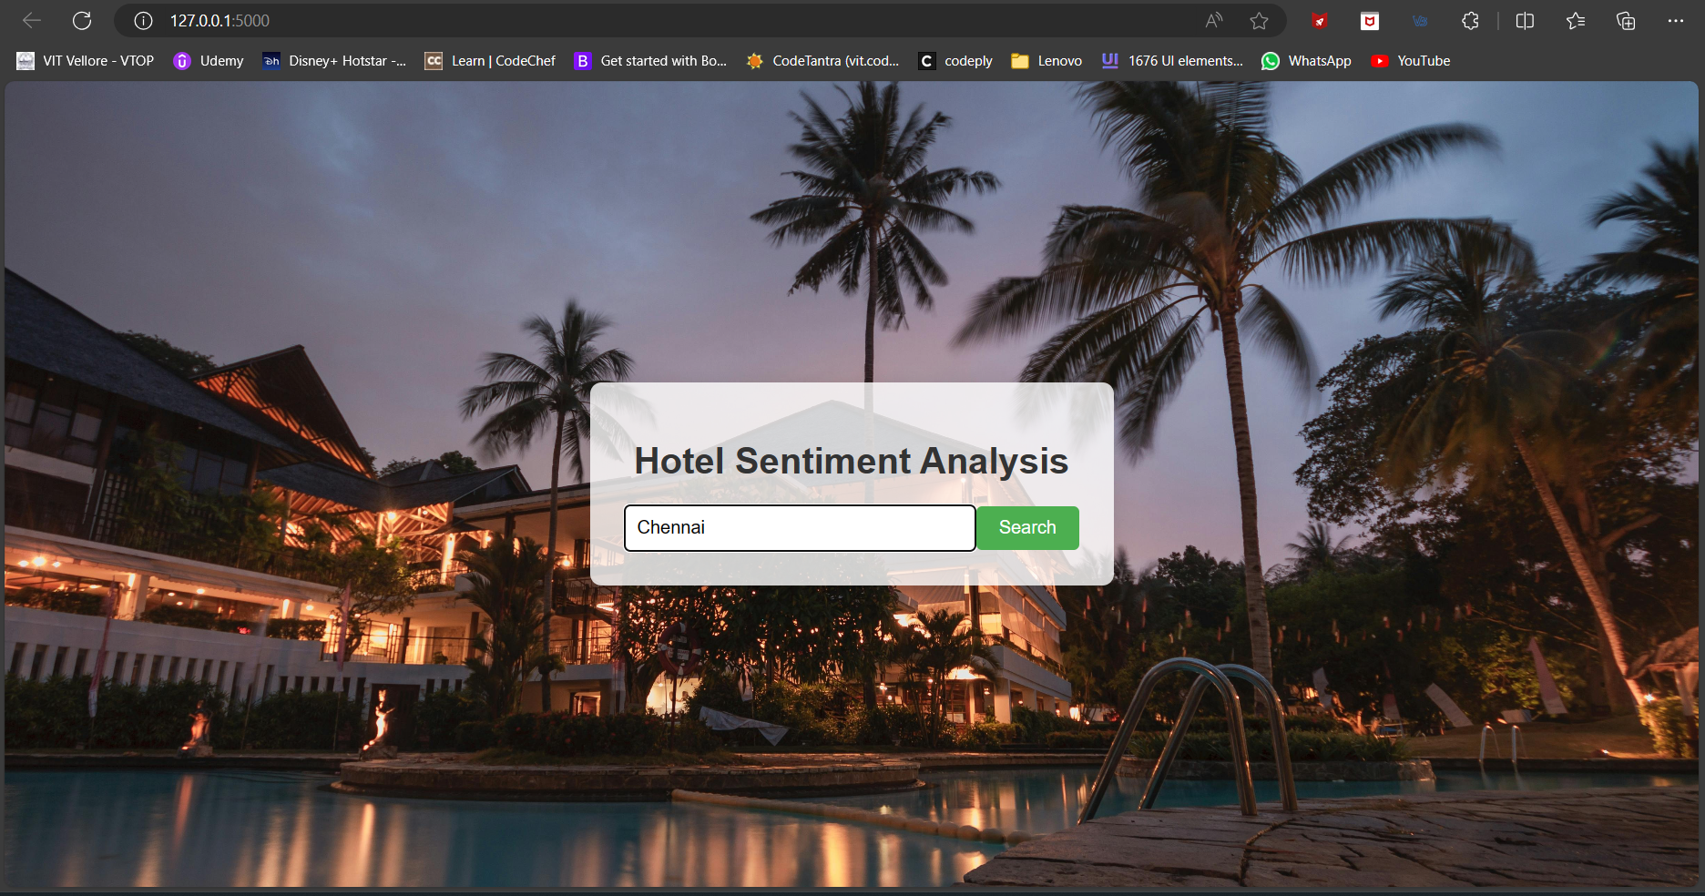
Implementation
Landing Page:
Enter the location here:

Slide 22
Algorithms Used:
Web Scraping Algorithm:
Description: The web scraping algorithm is implemented using BeautifulSoup, a Python library for parsing HTML and XML documents. It follows these steps:
Send an HTTP GET request to Booking.com to retrieve the HTML content of the search results page for the specified location.
Parse the HTML content using BeautifulSoup to extract relevant information about each hotel, such as name, location, rating, and URL.
Iterate through the extracted data and store it in a structured format for further processing.

Slide 23
Algorithms Used:
Sentiment Analysis Algorithm:
Description: Sentiment analysis is performed on hotel reviews using the VADER (Valence Aware Dictionary and sEntiment Reasoner) sentiment analyzer from the NLTK library. The algorithm proceeds as follows:
Retrieve hotel review data by following the URLs extracted during web scraping.
Extract review text from the HTML content of each hotel's review page.
Apply sentiment analysis using VADER to assign sentiment scores to each review, which quantify the positivity or negativity of the text.
Calculate the average sentiment score for each hotel by aggregating the sentiment scores of its reviews.
The sentiment scores are then used to rank hotels, with higher scores indicating more positively reviewed hotels.

Slide 24
Algorithms Used:
Geocoding Algorithm:
Description: Geocoding is the process of translating addresses or location names into geographic coordinates (latitude and longitude) that can be used to pinpoint the location on a map. The algorithm proceeds as follows:
Construct a request URL for the geocoding service (in this case, the Nominatim API) with the address or location name as a query parameter.
Send an HTTP GET request to the geocoding service with the constructed URL.
Receive a response from the geocoding service, typically in JSON format, containing the geographic coordinates corresponding to the provided address or location name.
Parse the JSON response to extract the latitude and longitude coordinates.
Return the extracted coordinates to the calling function or use them for further processing, such as displaying the location on a map.

Slide 25
07
Results

Slide 26
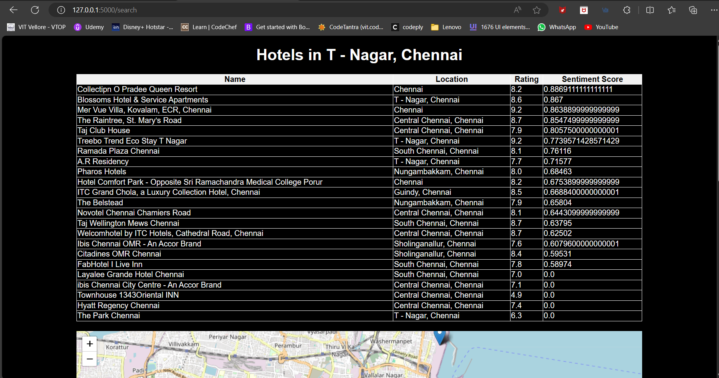
Results:
Sentiment Scores of Hotel in Chennai:

Slide 27
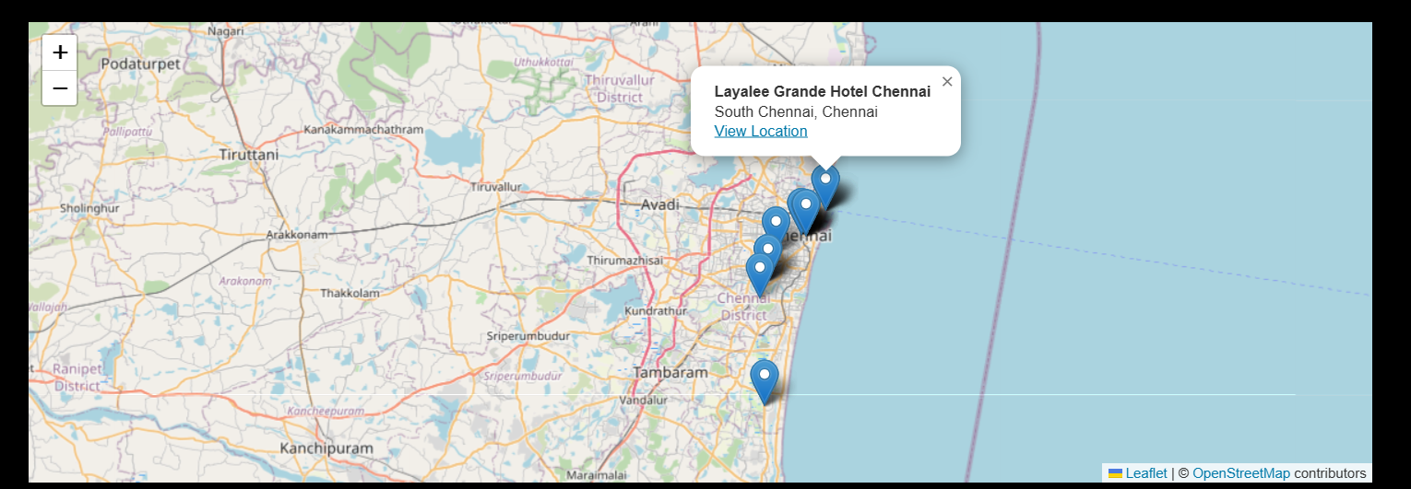
Results:
Locations of hotel in map:

Slide 28
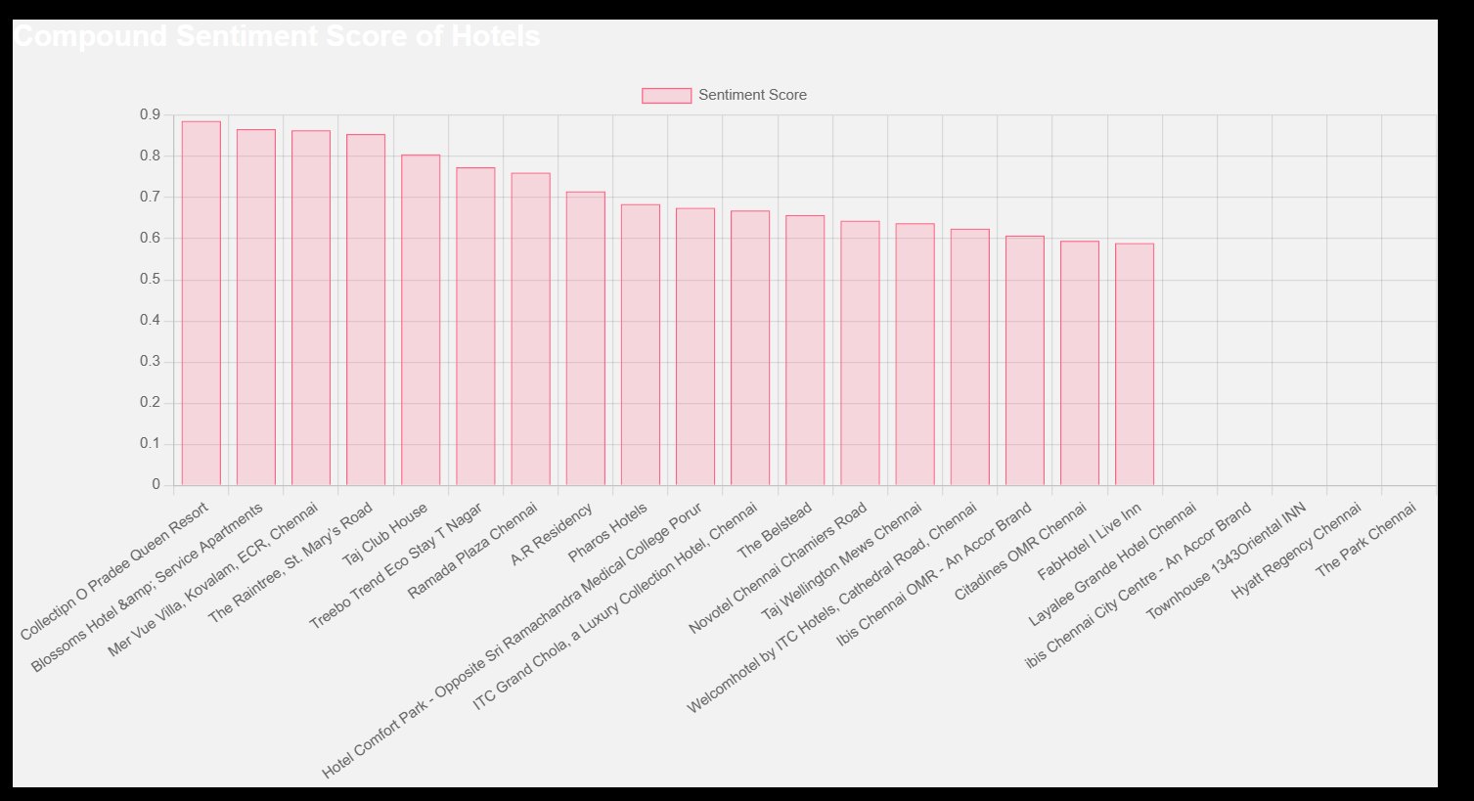
Results:
Bar chart:

Slide 29
Observations:
The flask application first fetches data from Booking.com. When users input a location, it retrieves hotel details like names, locations, and ratings from Booking.com. The application also uses the VADER sentiment analyzer to analyze customer reviews for each hotel. It then displays the results on a webpage, sorted by sentiment score, helping users prioritize hotels with positive reviews. Alongside the hotel listings, it includes a map showing hotel locations and a bar chart displaying sentiment scores. This comprehensive approach enables users to make informed decisions, considering both ratings and sentiment analysis of customer feedback, for a convenient and insightful hotel search experience.

Slide 30
08
Conclusion

Slide 31
Conclusion:
In conclusion, this Flask application effectively combines web scraping, sentiment analysis, and data visualization techniques to provide users with a robust platform for hotel searching and decision-making. By integrating data from Booking.com, sentiment analysis of customer reviews, and interactive visualizations, the application empowers users to make informed choices when selecting accommodations. The user-friendly interface, coupled with the ability to sort and visualize hotel data based on sentiment scores, enhances the overall user experience and enables users to prioritize hotels based on both quantitative ratings and qualitative sentiments. This application serves as a valuable tool for travelers seeking accommodations, offering them a comprehensive solution that integrates data-driven insights with user-friendly functionality.

Slide 32
Thanks!
Does anyone have any questions?

